Slide 1


by René Jansen
Notes:
Our mission, together with our partners, is to make a difference by promoting working for people.

Slide 2

Thank you
Notes:
Dear management of UWV.
I want to thank you for inviting me at your headquarters in Amsterdam. I appreciate it that you made available data to the public
In the past couple of days I studied your data , I wrangled it, improved it and sliced it.
To be honest, especially for personal reasons I chose to study your data and I was hoping to get insights about opportunities for data analist
Since I want to switch my carreer back to ICT.
So I started to analyse all data regarding ICT<NEXT>

Slide 3
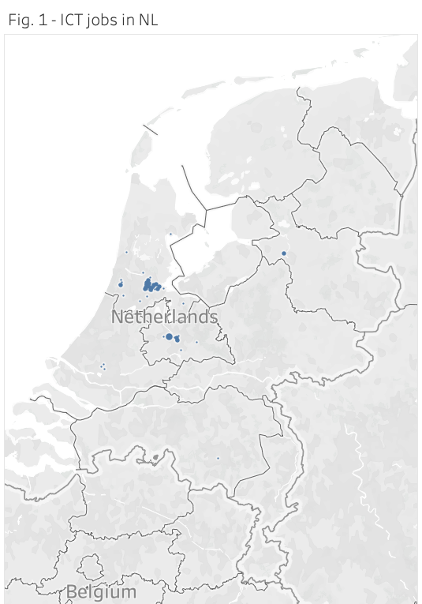
ICT and DA job seekers
nobody available
there is nothing here to analyse
Notes:
<pauze>
There’s nothing to explore <NEXT>

Slide 4
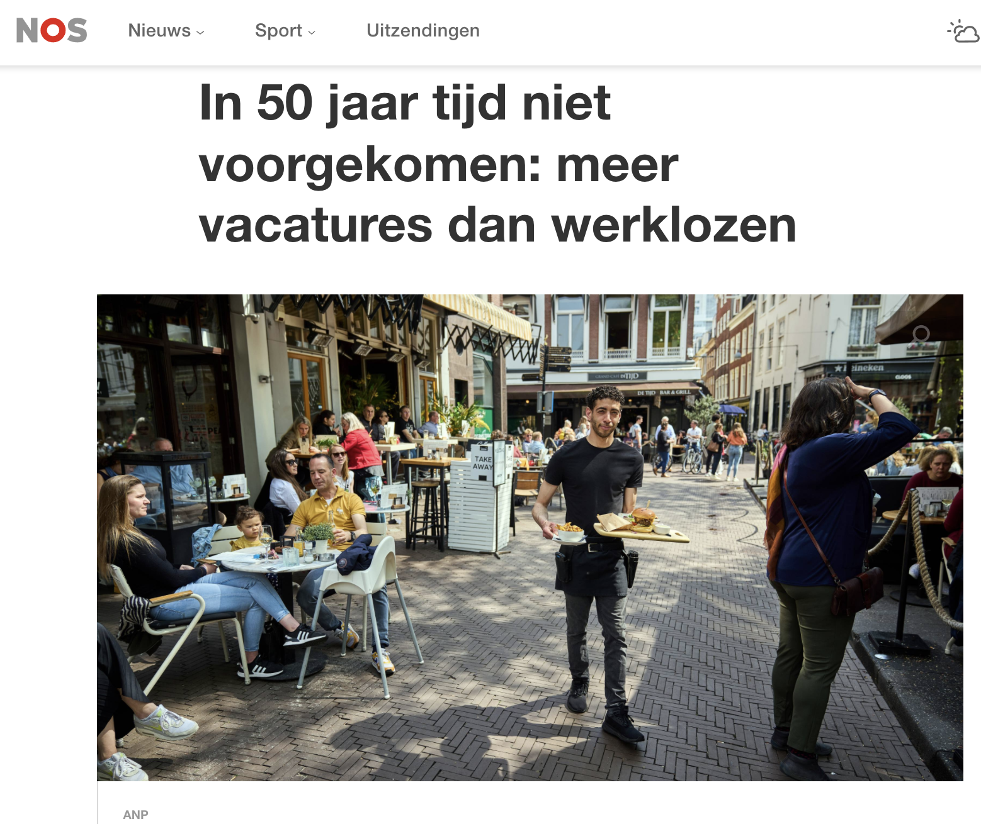
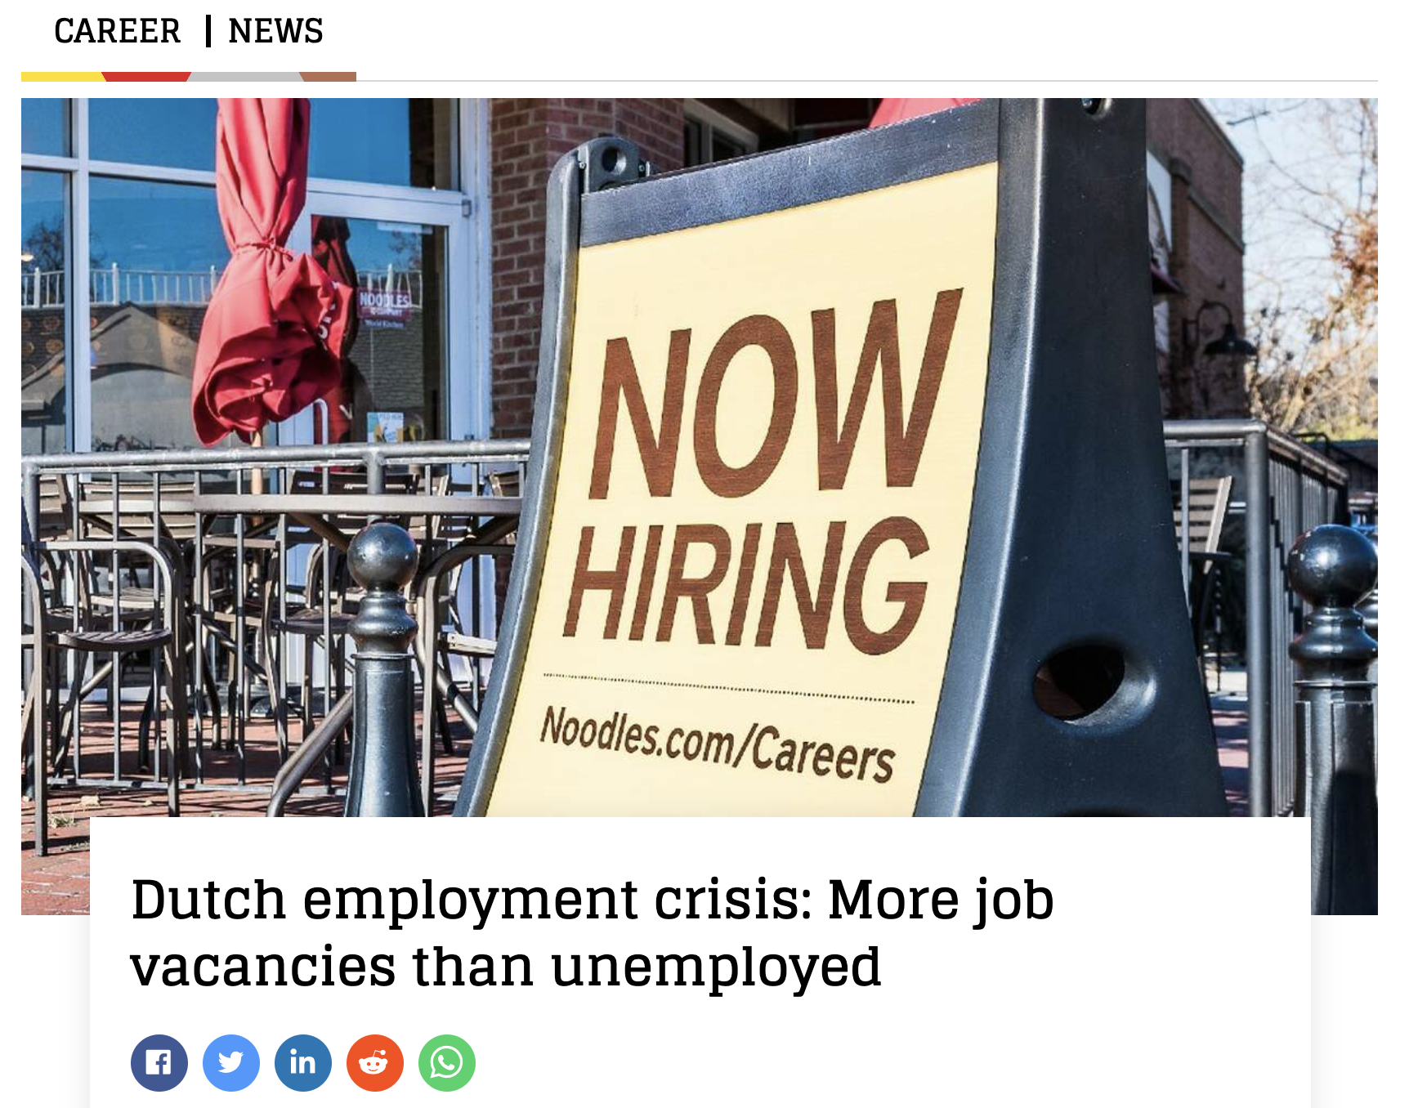
Notes:
I think practically every person in the netherlands who can hold a mouse is considered ICT specialist of analyst and is currently employed in some way.
So I changed the main questions of my research.
Instead I want to discuss with you the value of data analytics for your organisation, especially regadring your mission
Since your agency wants to be leading the employment market. Well, work has to be done, because there are more vacancies than unemployed people

Slide 5
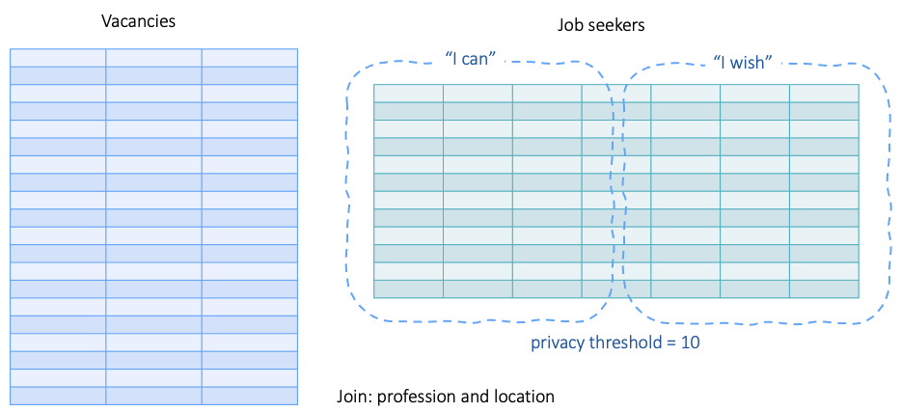
Open data UWV: 3-in-1
Notes:
I understand that your organization has a responsability towards privacy. You don’t put individual data points in the open, so it could be traced back to a person. It’s all aggregated data, that’ fine
And in fact I had to seperate information about vacancies first and information about job seekers, which can als o be devided in “I wish to have this job” and “I am experienced to do this job”.

Slide 6
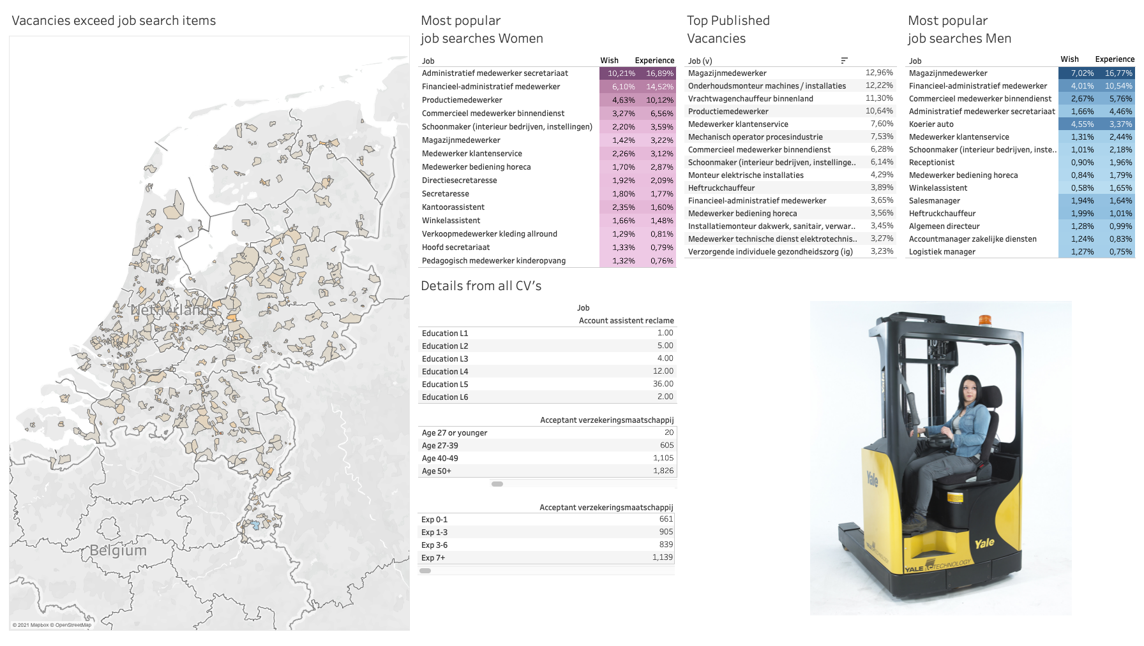
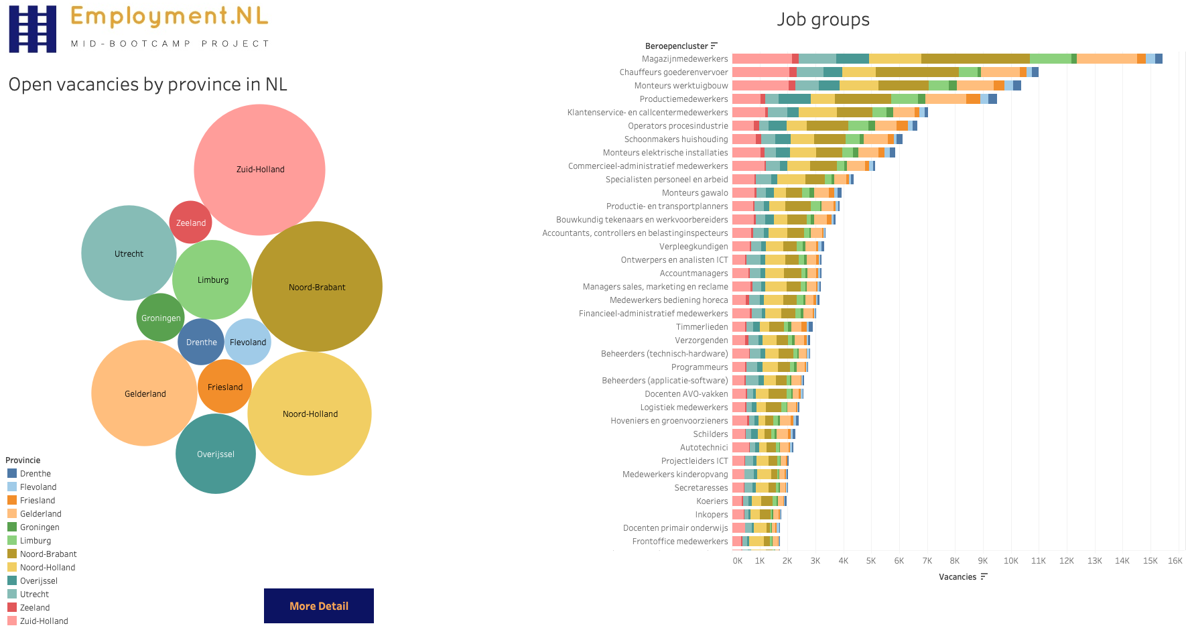
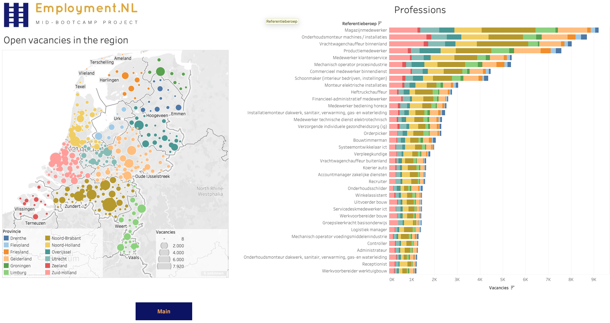
Dashboards

Slide 7
Insights from your open data
Less job groups
More features in the data for oportunities for women
This is only on aggregated data, imagine on the real data
This is just few day’s work … if I can
With data analytics you can bring valuable insights to the region and work together on job matching programs
All people @ work
Notes:
You manage the UWV. An organization that offers people without a job perspective. It is your mission, together with your partners, to make a difference by promoting working for people.
I a few day’s time I created insights with your data. From Amsterdam you can show your partners in Venlo that there should not be more than one hundred open vacancies for the job of Warehouse Worker.
As the central agency for employment data analytics should be a permanent part of your business operations, as a core competence as part of your mission and service to your partners
Thanks you for the attention and the opportunity to share my insights

